Slide 1
CIS8695: Managing Big Data Analytics
Nasim Mousavi
Assistant Professor
J. Mack Robinson College of Business
Georgia State University
nmousavi@gsu.edu

Slide 2
Logistic Regression

Slide 3
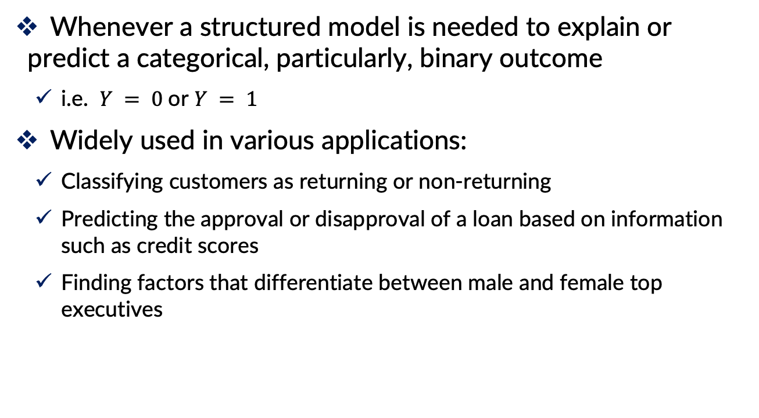
Applications
Whenever a structured model is needed to explain or predict a categorical, particularly, binary outcome
i.e. $Y = 0$or $Y = 1$
Widely used in various applications:
Classifying customers as returning or non-returning
Predicting the approval or disapproval of a loan based on information such as credit scores
Finding factors that differentiate between male and female top executives

Slide 4
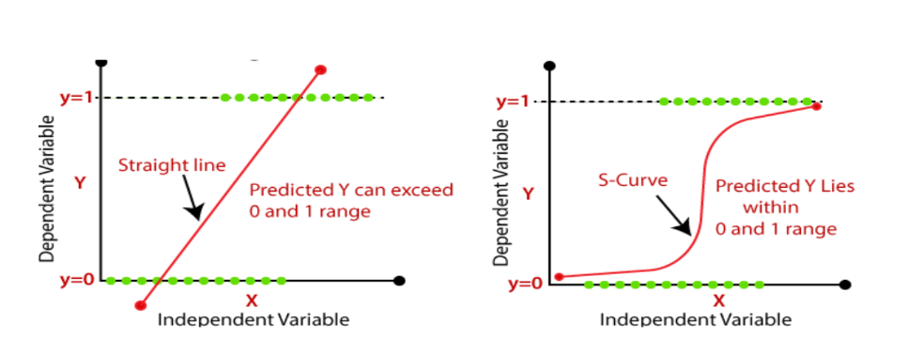
Logistic Regression
Y = Obese (1) / Not Obese (0)
X = Weight

Slide 5
Logistic Regression

Slide 6


Solution: Using Sigmoid Function
$$y=β_{0}+β_{1}x$$
$y=\frac{1}{1+ e^{−{(β}_{0}+β_{1}x)}}$

Slide 7
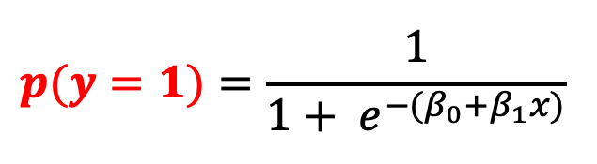
What Does Sigmoid Function Tell Us?
$$p(y=1)=\frac{1}{1+ e^{−{(β}_{0}+β_{1}x)}}$$

Slide 8
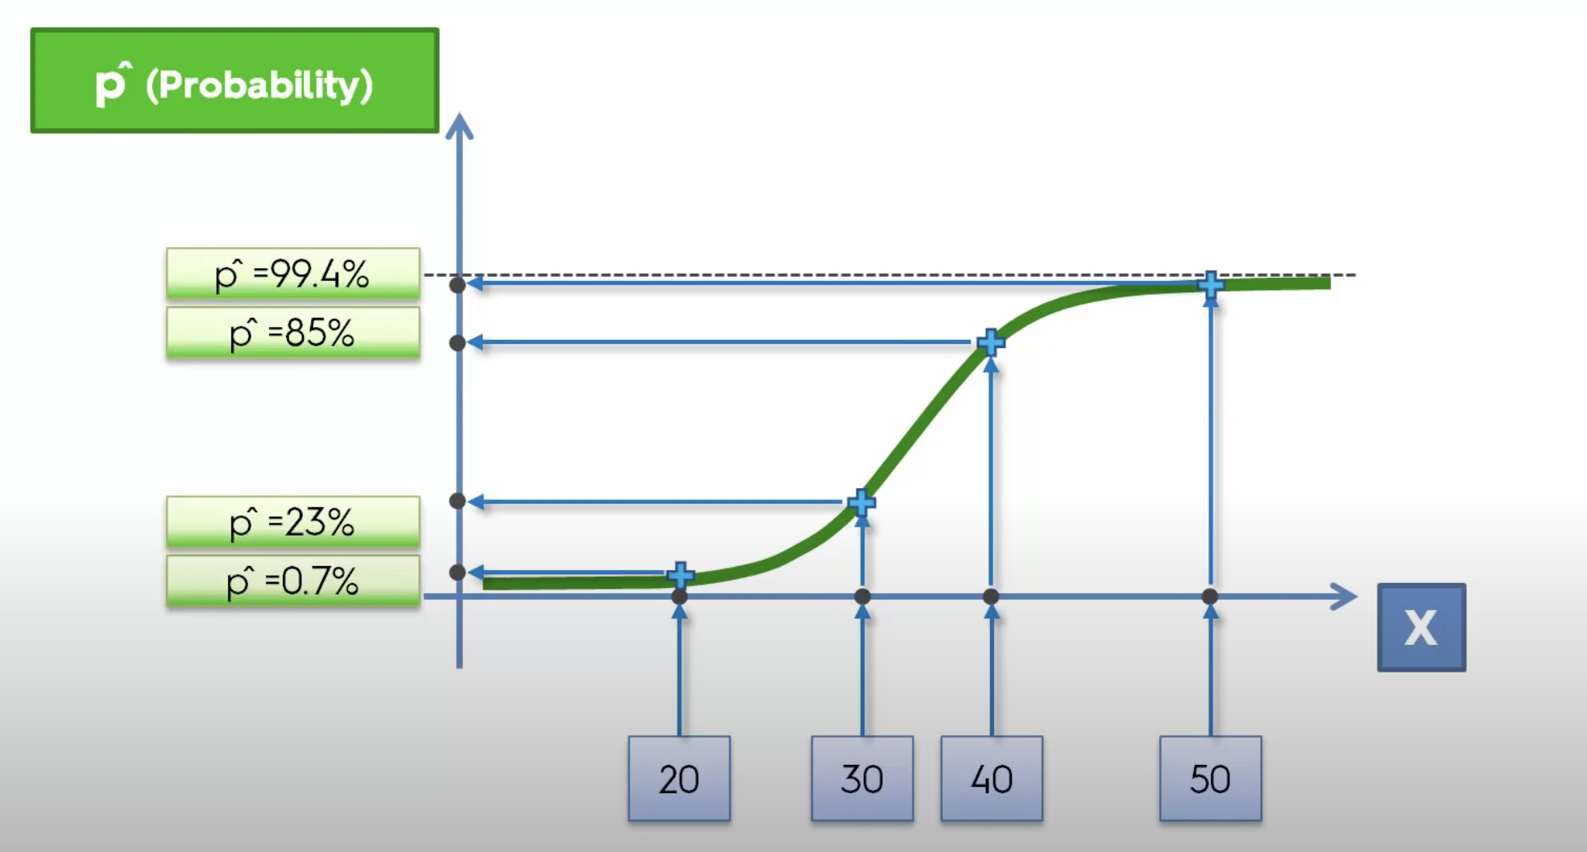
Logistic Regression

Slide 9
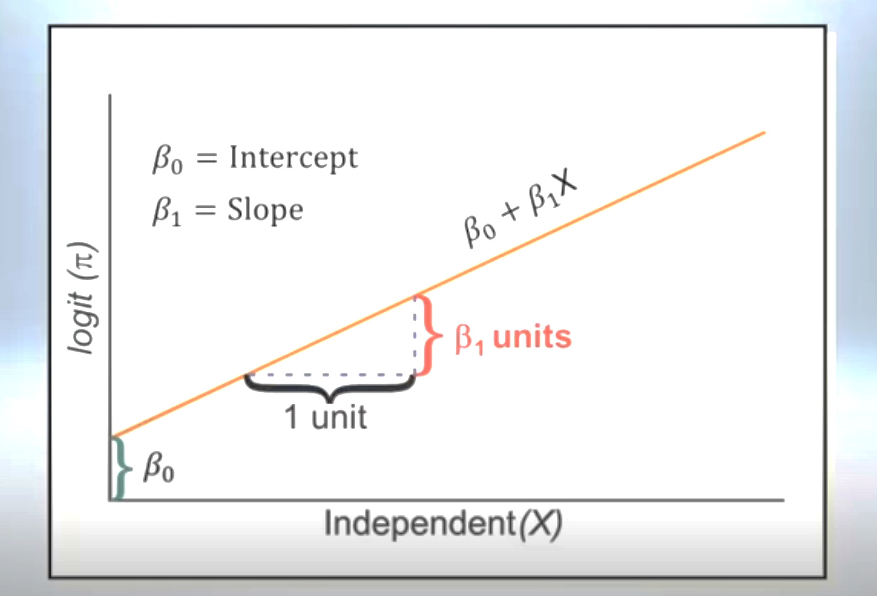
Coefficient Interpretation
But will there be a way to transform the sigmoid function to a linear function?
To interpret the coefficients easier in a more meaningful way

Slide 10


Using Odds for the Linear Transformation
$p=P\left(Y=1\right)$= Probability of belonging to class 1
Odds: Different measurement of belonging to a class
The odds of an event are defined as:
$$Odds\left(Y=1\right)=\frac{p}{1−p}$$
Probability of belonging to class 1
Probability of belonging to class 0
Logit Function

Slide 11
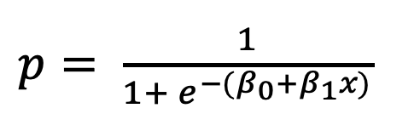

Logistic Regression
$p= \frac{1}{1+ e^{−{(β}_{0}+β_{1}x)}}$
$$logit\left(p\right)=log\left(odds\right)=β_{0}+β_{1}x$$
Logit (p)

Slide 12

Coefficients Interpretation
If we increase x₁ by one unit, holding x₂, x₃ … x_{q} constant, then $e^{β_{1}}$ is the factor by which the odds of belonging to class 1 increases

Slide 13
Logistic Regression for Classification

Slide 14
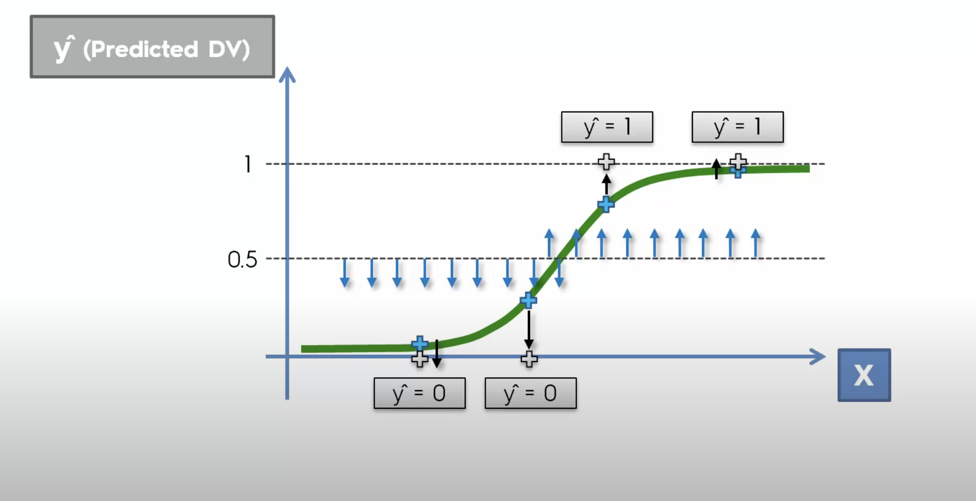
Logistic Regression for Classification

Slide 15
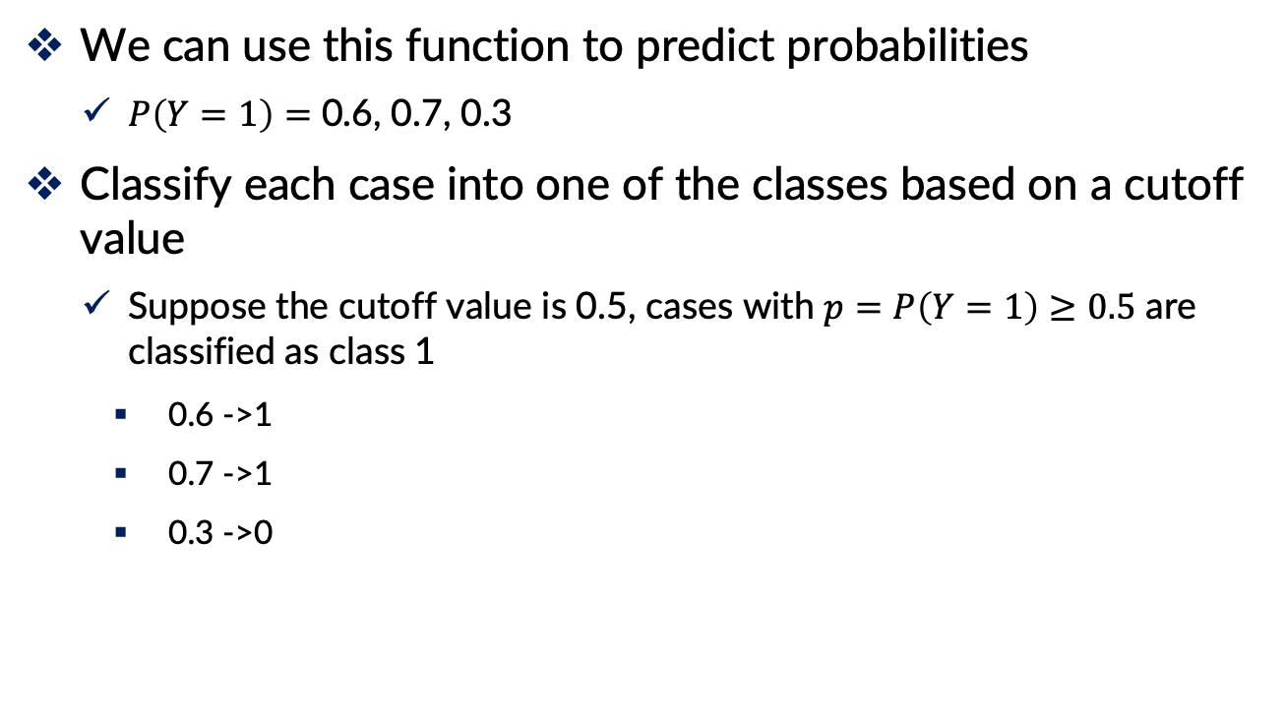
Logistic Regression for Classification
We can use this function to predict probabilities
$P\left(Y=1\right)=$ 0.6, 0.7, 0.3
Classify each case into one of the classes based on a cutoff value
Suppose the cutoff value is 0.5, cases with $p=P\left(Y=1\right)≥0.5$ are classified as class 1
0.6 ->1
0.7 ->1
0.3 ->0

Slide 16
Ways to Determine Cutoff
0.5 is popular initial choice
Additional considerations (see Chapter 5)
Maximize classification accuracy
Maximize sensitivity (subject to min. level of specificity)
Minimize false positives (subject to max. false negative rate)
Minimize expected cost of misclassification (need to specify costs)

Slide 17
Example

Slide 18
Personal Loan Offer
Goal: Identify customers who are more likely to accept the loan offer in future mailings
Outcome variable: Accept loan (0/1)
Predictors: Their last response to loan campaign, demographic info (Age, income, etc.), customers’ relationship with bank (mortgage, securities account, etc.)

Slide 19
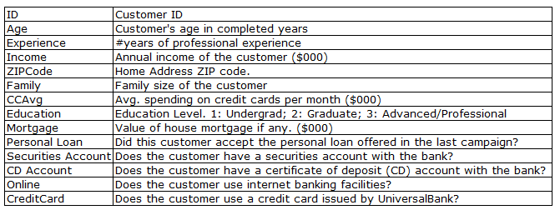
Personal Loan Offer

Slide 20
Data Preprocessing
Similar to linear regression
Missing values
Categorical inputs
Nonlinear transformations of inputs
Variable selection (including avoiding multicollinearity)

Slide 21
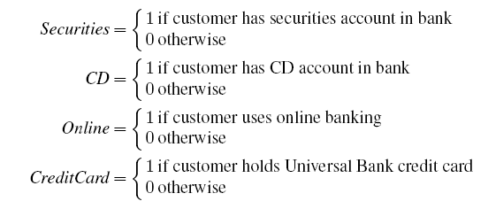
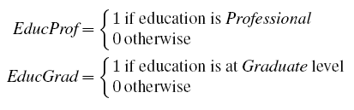
Data preprocessing
Create 0/1 dummy variables for categorical predictors
Partition 60% training, 40% validation

Slide 22
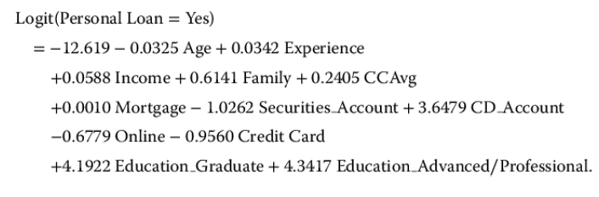
Example, continued
What does the coefficient tell us? (like education_graduate)
Having graduate education is associated with higher probabilities of accepting the loan offer

Slide 23

Example, continued
What does the coefficient tell us, in terms of odds? (like CD account)
$e^{3.6479}$= 38.4 are the odds that a customer who has a CD account will accept the offer relative to a customer who does not have a CD account, holding all other variables constant

Slide 24
Evaluating Classification Performance
Performance measures
Confusion matrix
% of misclassifications
Use the estimated equation to predict the probability of class membership for each record in the validation set
Then compare these classifications with the actual class memberships to measure the accuracy

Slide 25
Evaluating Classification Performance
Confusion matrix
Note that all predictions: All = TP + FP + FN + TN
Some common metrics:
Accuracy = (TP + TN) / All
Precision = TP / (TP + FP: predicted positive)
Recall (Sensitivity) = TP / (TP + FN: actual positive)
Specificity = TN / (TN + FP)
Actual | Predicted
 | Positive, 1 | Negative, 0
Positive, 1 | True Pos. (TP) | False Neg. (FN)
Negative, 0 | False Pos. (FP) | True Neg. (TN)

Slide 26
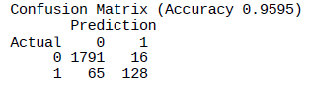

Evaluating Classification Performance
$$Accuracy= \frac{TP+TN}{All}=\frac{1791+128}{2000}=0.9595$$

Slide 27
Summary
Logistic regression is similar to linear regression, except that it is used with a categorical response.
It can be used for explanatory tasks or predictive tasks (=classification).
The predictors are related to the response Y via a nonlinear function called the logit.

